Slide 1
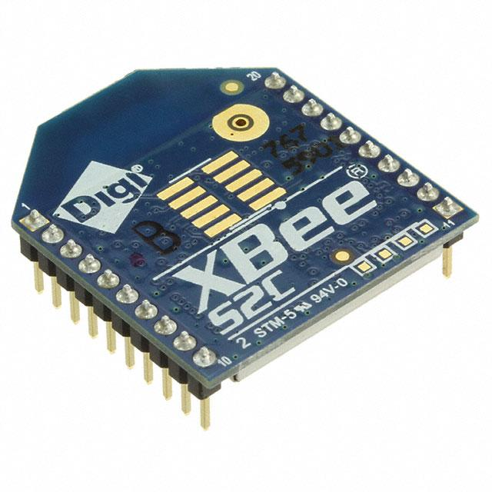
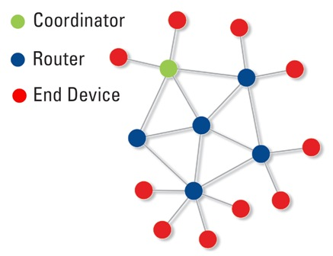
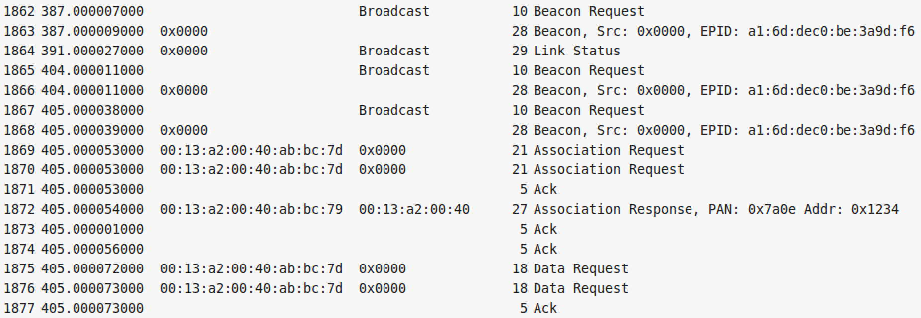
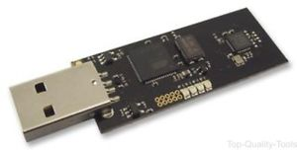
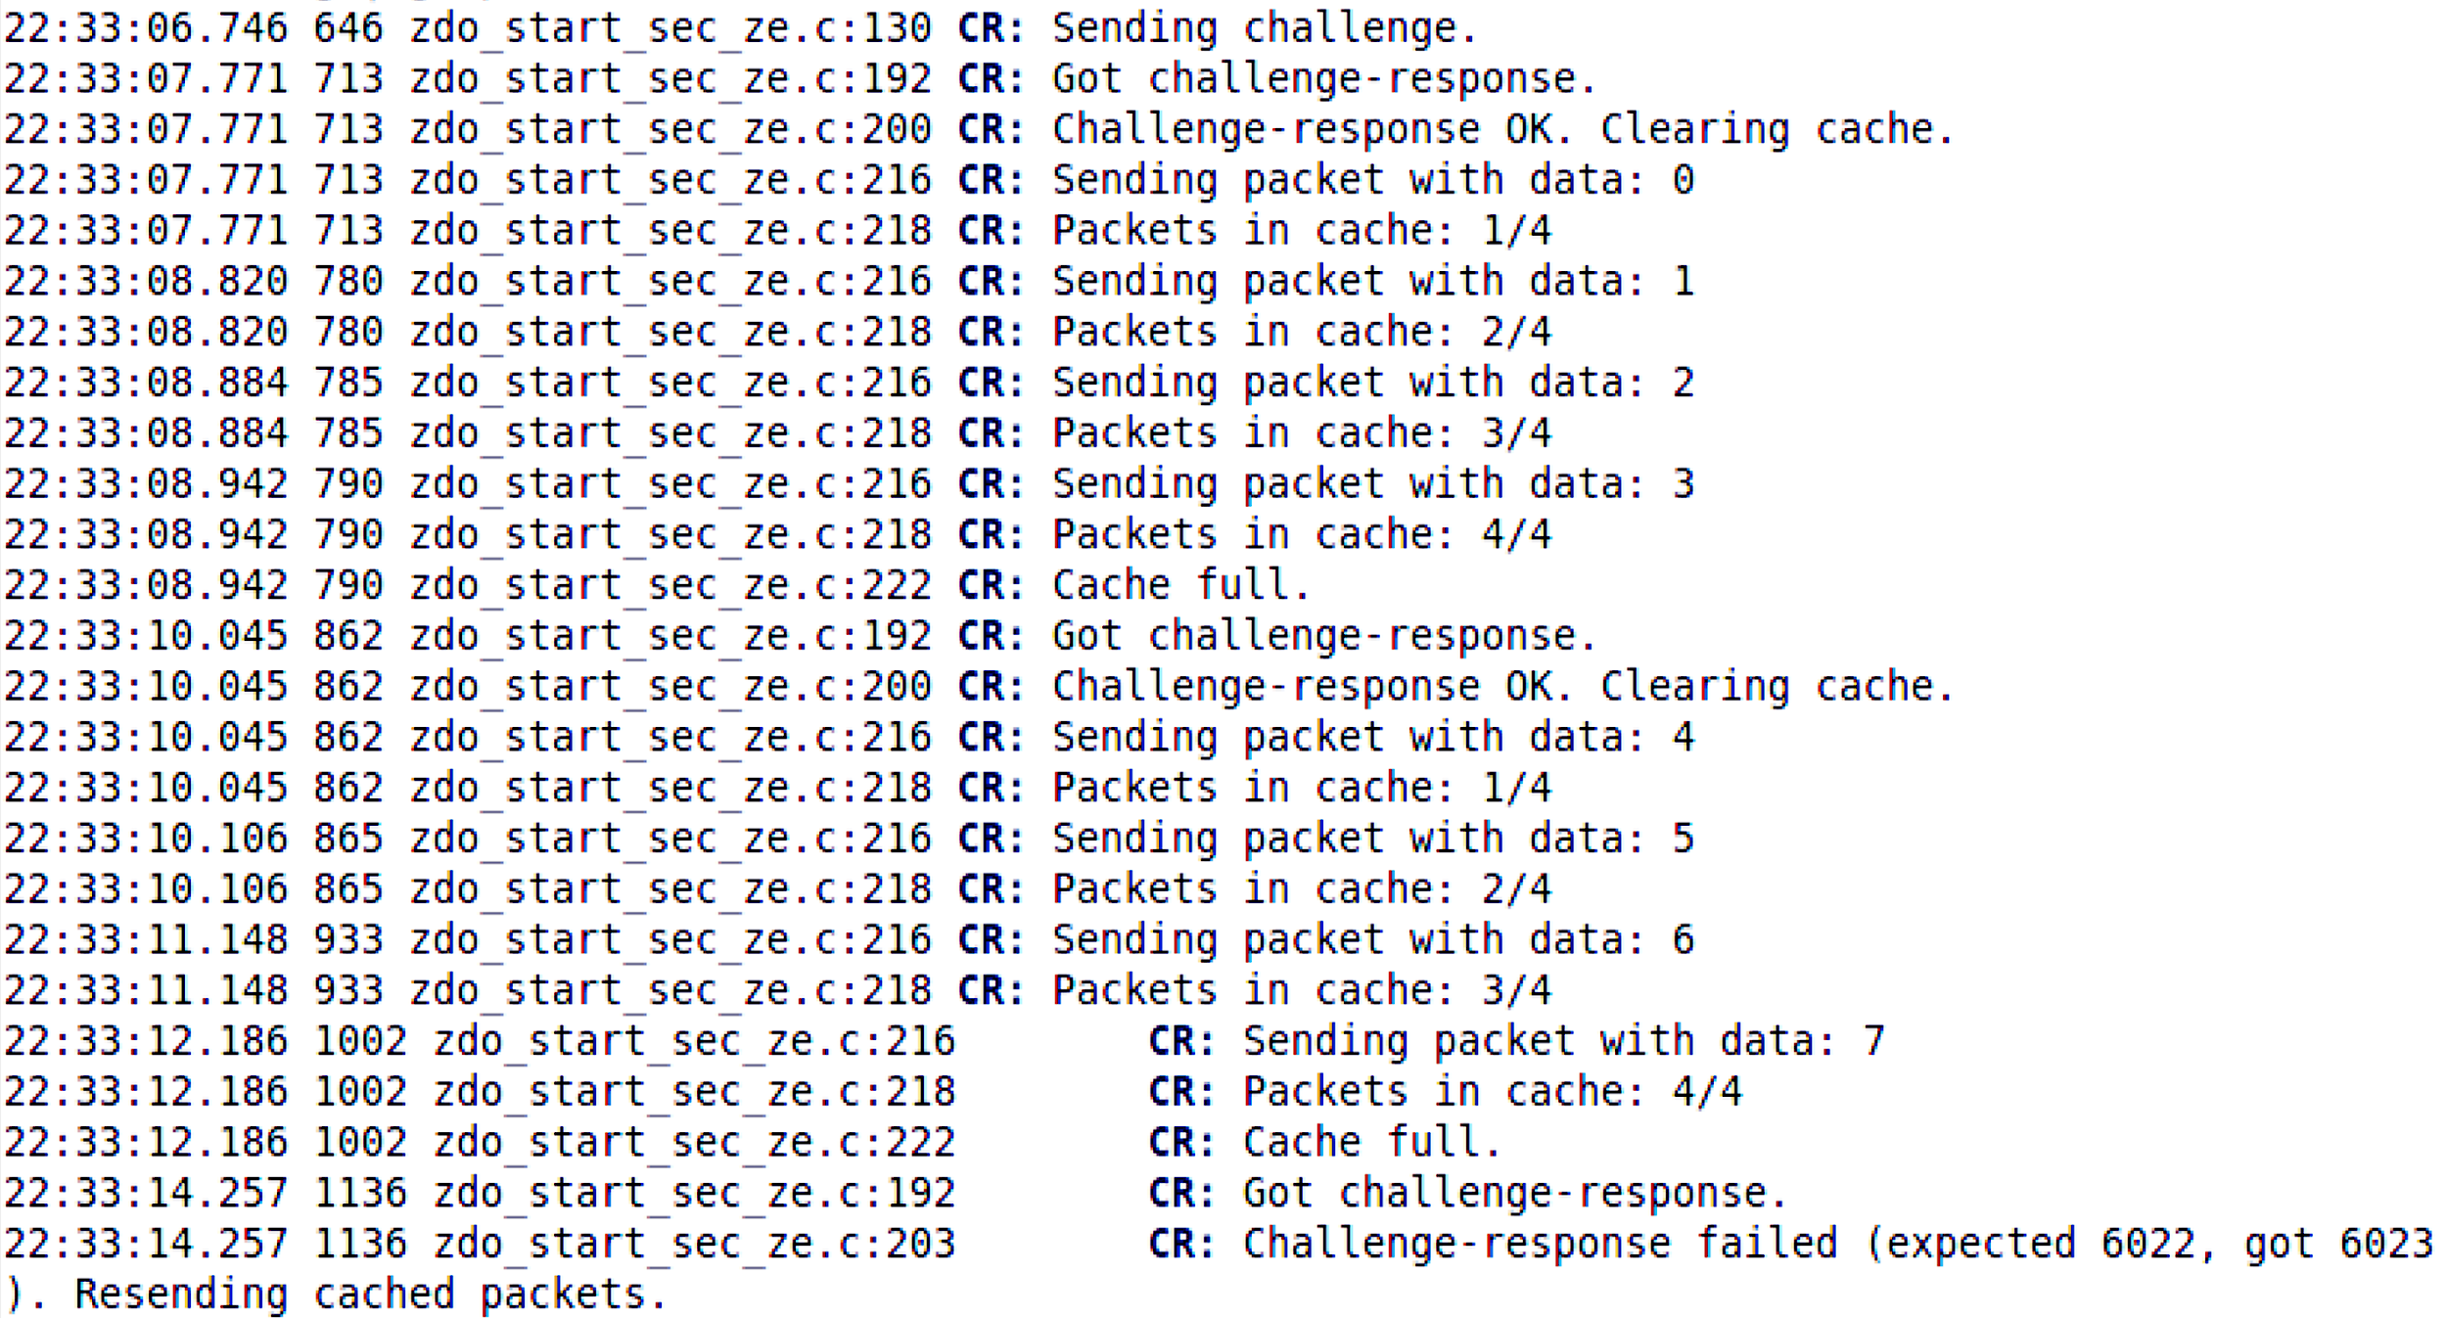
Inducing Data Loss in Zigbee Networks via Join/Association Handshake Spoofing
Spencer Michaels, Kemal Akkaya, A. Selcuk Uluagac Elect. & Comp. Engineering, Florida International University smichaels@hmc.edu, {kakkaya,uluagac}@fiu.edu
Introduction
Spoofing the Coordinator
Experimental Evaluation and Results
Zigbee is a popular IEEE 802.15.4-based specification for low-power mesh networks, frequently used for infrastructure control and monitoring
Zigbee’s ad-hoc network establishment and low power requirements seriously limit its security measures, creating a variety of attack possibilities
Spoofing the coordinator is possible since all packets in the join/association handshake are unencrypted.
We consider the handshake spoof successful if the end device sends data requests to the rogue node afterward (step 9 at left). This does indeed occur.
In order to facilitate the complete Wireshark capture below, the channel switch does not occur. Instead, the coordinator was manually switched off after step 2, producing the same effect as if steps 3 and 4 had occurred.
Joining device
Beacon request
Coordinator
2. Beacon
3. Assoc. request
1.
4. Assoc. response
3./4.*
2.
5.
All information needed to spoof can be obtained without breaking the network’s encryption
6.
5.
6.
7.
Joining device
Coordinator
8.
3. Beacon request
9.
4. Jam,
then switch
channel
to Y
10.
Problem
Because our own node’s hardware could not respond quickly enough to reliably ACK data requests, the connection only lasted for roughly a second.
Using a simulator, a preliminary implementation of the challenge-response system proved workable.
Given a Zigbee network composed of a coordinator (root) node and one or more child devices, and assuming that we cannot overcome the network's encryption, our goal is to induce loss of the data transmitted from an end device to the coordinator. As a secondary goal, we will propose a low-overhead countermeasure to our attack.
Many denial-of-service attacks, e.g. jamming or flooding, are straightforward and effective, but easily detectable. Our attack should not be readily apparent to the owners of the network, minimizing the amount of abnormal activity perceived by other devices.
Beacon
+ link status
10. ACKs
6. Beacon 5. Beacon request
2.
Channel Y
8. AscRsp.+ACK 7. AscReq.
Beacon request
Channel X
9. Data requests
Rogue node
Proposed solution
The end device caches recently transmitted data. When the cache is full, it sends a challenge to the coordinator, encrypted using the network key (which, by our assumptions, the rogue node does not know).
If the response is wrong/absent, the end device leaves, restarts the assoc. process, and resends cached data. If correct, it clears cache and continues.
Attack Overview
Acquire network information
Our fake node masquerades as a new device and issues a beacon request to get network information from the coordinator
Prevent a new device from discovering the network
Wait for a beacon request from a new device; corrupt it by jamming so the coordinator does not reply with network info.
Spoof the coordinator on another channel
Switch to a different channel (so as not to be noticed by the original network) and use information from step 1 to spoof the controller and carry out a handshake with the new device
End device
Conclusion
Packet #1 (cache 1 / N)
Coordinator
The handshake-spoofing attack does succeed.
However, hardware limitations prevented us from determining how long the end device can feasibly be kept connected
The challenge-response method has the potential to be an effective countermeasure.
If the end device’s memory permits a reasonably sized cache, the network resource cost will be low under normal conditions
...
Packet #N (cache N / N)
Challenge
Cache
Response
Pkt 1
[ Cache cleared ]
...
P. N+1
clear
...
Packet #(N+1) (cache 1 / N)
Pkt N
...
Notes:
1

